Slide 1


Primeasia University
Welcome To Our Mini Project
A mission with a vision
Project Name: Mini Radar

Slide 2
Submitted to:
Mostofa Kamal Sagor
Lecturer Department of CSE
Primeasia University

Slide 3
Our Team Member
Name: Md Alif Hossain.
ID: 193009042
Department of CSE.
Primeasia University.
City : Kishoregonj,Bangladesh.
Email : alifakonda@gmail.com
Name: Mofazzal Hossain.
ID: 193021042
Department of CSE.
Primeasia University.
City :Kishoreginj ,Bangladesh.
Email : mofazzalhossain91966@gmail.com
Name: Md Arif Uddin.
ID: 193027042
Department of CSE.
Primeasia University.
City : Hobiganj,Bangladesh.
Email : arifuddin3659@gmail.com

Slide 4
ABSTRACT:
The Subset-sum Problem is one of the easiest to describe and understand NP-complete problems. Available algorithms that solve this problem exactly need an exponential time, thus finding a solution to this problem is not currently feasible. The current paper revisits the subset-sum problem and suggests a new approach to find an approximate solution to this problem. The proposed algorithm gives a reasonable solution with a polynomial time-complexity.

Slide 5
Introduction:
Radar is an object detection system that uses electromagnetic waves to identify range, altitude, direction, or speed of both moving and fixed objects such as aircraft, ships, vehicles, weather formations, and terrain. When we use ultrasonic waves instead of electromagnetic waves, we call it ultrasonic radar .
The main components in any ultrasonic radar are the ultrasonic Sensors. Ultrasonic sensors work on a principle similar to radar or sonar which evaluates attributes of a target by interpreting the echoes from radio or sound waves respectively.
Radar’s information will appear in different ways. Basic and old radar station used sound alarm or LED, modern radar uses LCD display to show detailed information of the targeted object. We use Computer screen to show the information (distance and angle).
In this technical project, we make a simple radar using the ultrasonic sensor, this radar works by measuring a range from 3cm to 40 cm as non-contact distance, with angle range between 15˚ and 165˚.The movement of the sensor is controlled by using a small servo motor. Information received from the sensor will be used by “Processing Development Environment” software to illustrate the result on a PC screen.

Slide 6
Motivation for the project:
We have chosen this “Mini Radar” project because now a days we are very concern to safety issue. A radar can help us to be protected from the danger zone by seeing a LCD display where will shown the information like angle, distance and object situation with red color.
Our Mini Radar is just a demo of A Radar System by this processing we can develop a big radar that can have a big range coverage capacity.
Let, a danger zone where general person is not allowed and if we want to protect personas we have to appoint a person for safety guard and for this persona we have to pay salary. If we can coverage a danger zone by a radar system and show a big LCD display with message and red signal then people can understand that this place is not secure they should have kept distance.
Radar System is not a too much costly system. For this reason we can easily effort this and we can easily use it where we think to need a security.

Slide 7
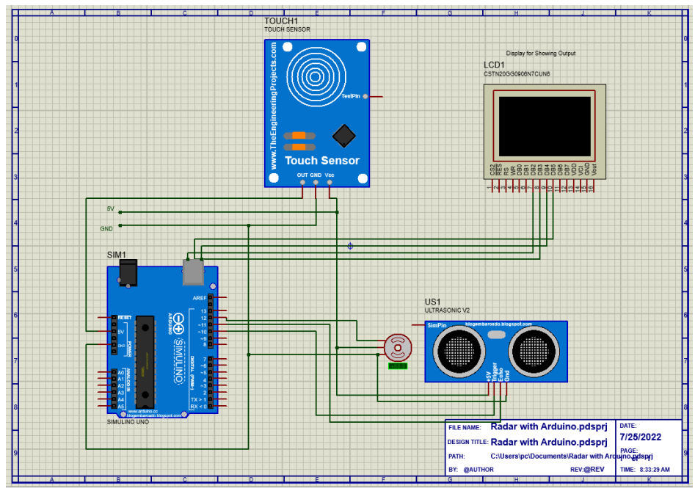
Circuit diagram:
Figure: Mini Radar Diagram in Protius Software

Slide 8
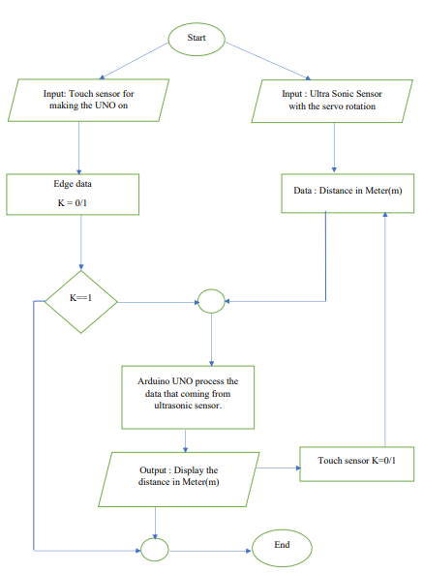
Working diagram:
No
Yes
Figure: Flowchart of Mini Radar Project

Slide 9
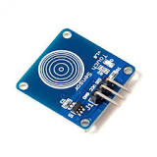
Sensor details:
Sensor – 01 : Touch Sensor
Figure: Touch Sensor.
Specifications :
Genre : This allows for touch sensing with only a single pin!
Here are its specifications:
Operating Voltage: 3 ~ 5.5V.
Model : HW -139.
Metric : switching or providing voltage (3 ~ 5.5V).
Application: Touchpad Laptop, Android/Mobile phone, Tablet computers.
Reason to choose: Touch sensors are more sensitive, and are often able to respond differently to different kinds of
touch. But we choose touch sensor to provide the voltage (3 ~ 5.5V) to Arduino .

Slide 10
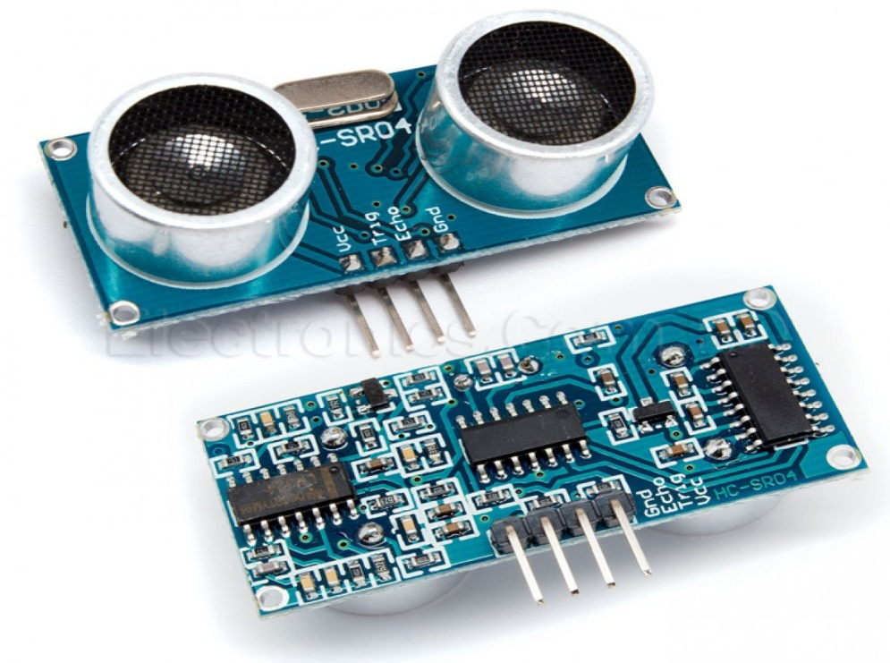
Sensor – 02 : Ultra Sonic Sensor:
Figure: Ultrasonic Sensor.
Specifications :
Genre : It can measure the distance of object .
Model : HC-SR04.
Metric : Detect the object distance in meter(Unit : m)
Application:
• Stacking height control
• Loop control
• Liquid level control
• Full detection
• Counting people/people detection
• Presence detection
Reason to choose: Detect the object distance.

Slide 11
Limitations:
RANGE DISCRIMINATION:
It is the ability of the RADAR set to clearly distinguish two small targets on
the same bearing at slightly different ranges.
MINIMUM RANGE:
THE PULSE LENGTH : This radar works by measuring a range from 3cm to 40 cm as non-contact distance, with angle range between 15˚ and 165˚.

Slide 12
Conclusion:
Radar is normally used to determine velocity, range, and position of an object. In this technical project, we read the distance and angles of detected objects in order to convert these data into visual information. The performance of our project is so good. It works smoothly to detect objects within the designed range. The screen shows the information clearly with enough delay for the user to read it. This project could be helpful for object avoidance/ detection applications. This project could easily be extended and could be used in any systems may need it.

Slide 13
Thanks Everyone

